Slide 1
Personal Audio
Winter Project

Slide 2
Objective
Achieve acoustic contrast control at specified bright zone and dark zone for personal audio systems.
Accommodating changing room environment to ensure consistent acoustic contrast.

Slide 3
Approach
Using Kalman filter (1) to estimate dynamic channel response of the room via feedback from microphones at control points.
Using BACC approach(2) to estimate inverse filter to be applied to speaker array to achieve said acoustic contrast.
Combining the approaches in (1) and (2) to achieve primary objective of Personal Audio zones in dynamic room setting.

Slide 4
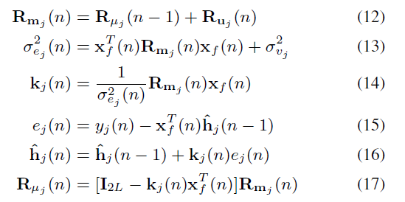
Kalman Filter
Update Equations

Slide 5
Kalman Filter
Simulated channel response via RIR generator (3)
Estimated channel response via Kalman Filter (512 iterations)
Percentage error: 5.4266

Slide 6

BACC - Broadband Acoustic Contrast Control
5 speaker array
Without filter
With filter

Slide 7
BACC - Broadband Acoustic Contrast Control
7 speaker array
Without filter
With filter

Slide 8
BACC - Broadband Acoustic Contrast Control
10 speaker array
Without filter
With filter

Slide 9
BACC - Broadband Acoustic Contrast Control
15 speaker array
Without filter
With filter

Slide 10
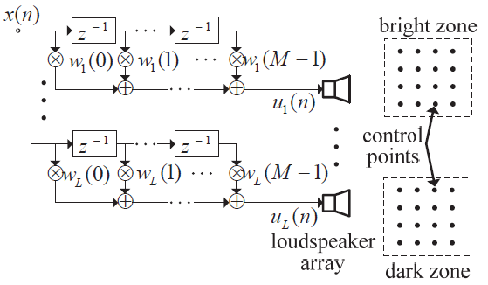
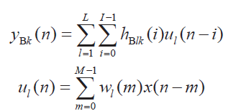
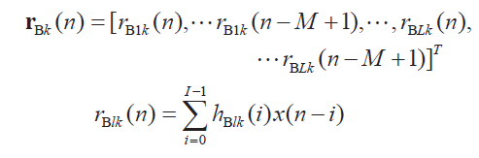
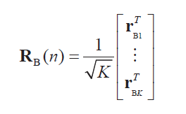


BACC - Broadband Acoustic Contrast Control

Slide 11
Problems faced
Kalman Filter
The accuracy seems to vary based on input signal.
Tweaking of various parameters like variance of v and w is needed as they greatly affect the accuracy of estimated channel on adding noise.
Minimum possible SNR which our filter can tolerate is 100. Below that, the percentage error seems to be higher than 10. Real life situation might involve higher noise than our tolerance.
BACC
The main problem faced is calculating inverse filter takes large amounts of time. This is due primarily to the fact that the inverse of an L*M dimensional matrix (M is filter length, L is number of speakers).

Slide 12
Problems faced
The paper we used uses a linear speaker array. But it doesn’t mention any other geometries which might give better results.
We calculate the filter by averaging filters over the signal duration to achieve the acoustic contrast. However, this can be greatly improved if time varying filters are used. However this is not feasible in the current model due to large time taken for filter calculation. So repeated filter calculations are not possible.

Slide 13
Suggested Improvements
The method given in the paper seems to provide an exact solution for minimization objective by finding eigenvector. However, if a time varying filter is attempted, it fails to utilise the prior learnt filter weights and attempts to recalculate from scratch which seems a waste of computational resources. A possible solution to this might be attempting to convert to an iterative method that gradually converges to the actual filter. This will be more efficient as we will have a good starting point since filter is not expected to change much over time.

Slide 14
Citations
JOINT ADAPTIVE IMPULSE RESPONSE ESTIMATION AND INVERSE FILTERING FOR ENHANCING IN-CAR AUDIO. - Ajay Dagar, Satyavolu Sai Nitish and Rajesh Hegde
DESIGN OF A TIME-DOMAIN ACOUSTIC CONTRAST CONTROL FOR BROADBAND INPUT SIGNALS IN PERSONAL AUDIO SYSTEMS - Yefeng Cai, Ming Wu, Jun Yang
Room Impulse Response Generator (Version 2.1.20141124) by Emanuel Habets Copyright (C) 2003-2014 E.A.P. Habets, The Netherlands.

